Slide 1
One Axis Automated Drill Project
Progress 24.06.2023

Slide 2
This week’s achievement:
Simultaneous function of sensors and motors running on one Arduino Mega 2560
Collection of data of force applied on PMMA at different drill speeds

Slide 3
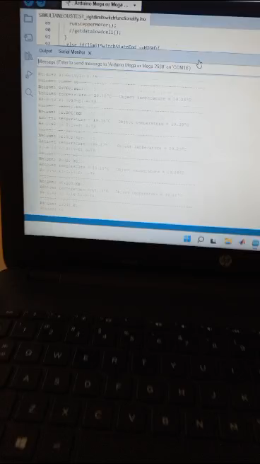

Slide 4
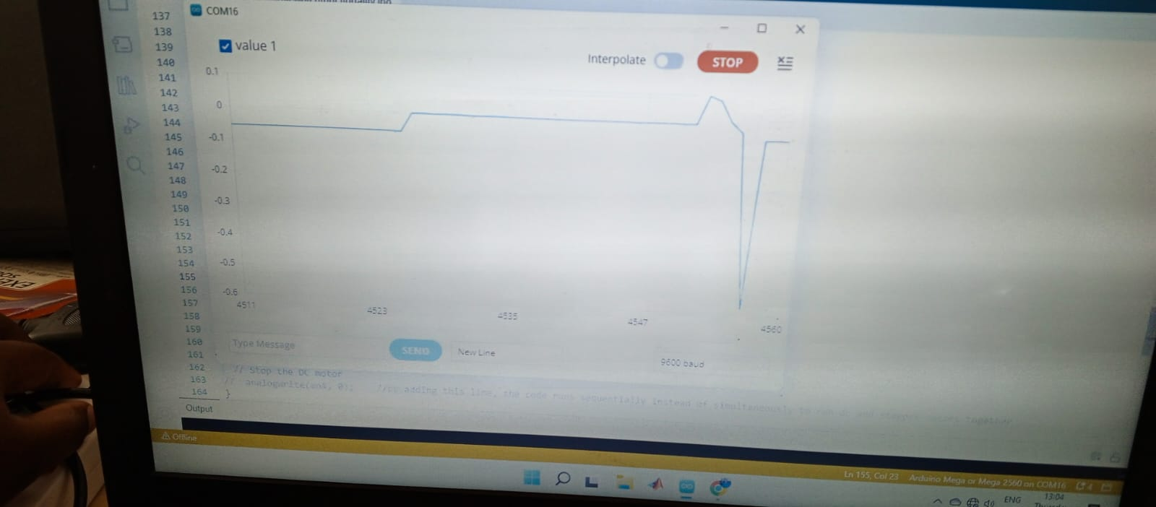
Plot of force applied on Perspex before drilling

Slide 5
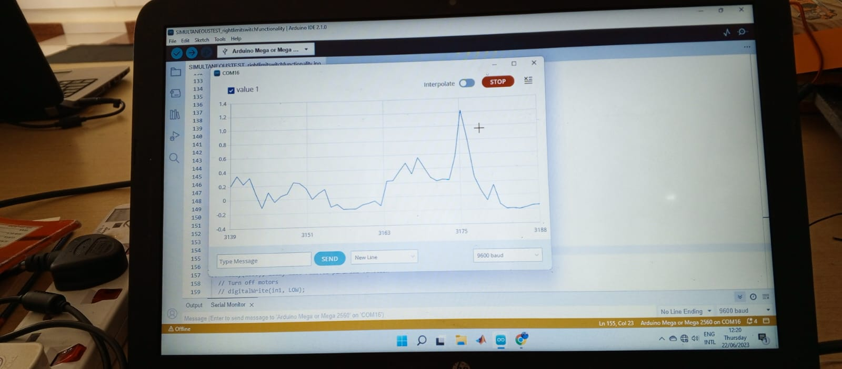
Plot of force applied on perspex during drilling

Slide 6
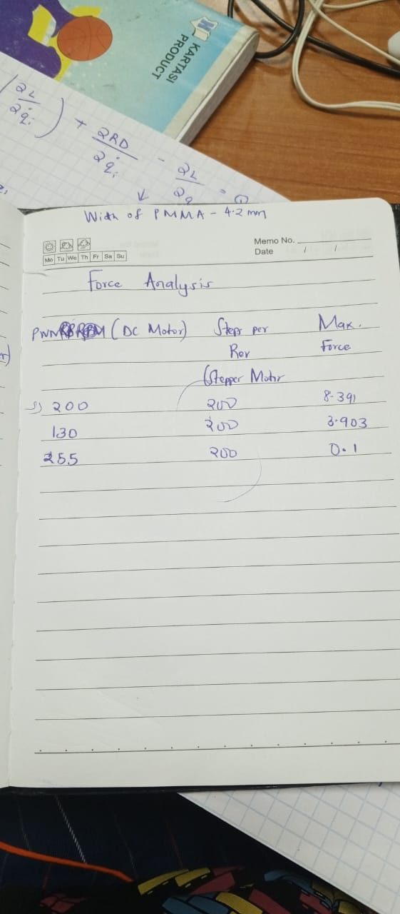
Some of the data collected before Perspex broke
First value of 8.391 kg was collected as peak force applied when drill bit stuck in the Perspex. The second value of 3.903 kg was recorded as peak value of force for one successful drilling operation as the dc motor is driven at a PWM value of 130. The third value was collected on driving the dc motor at maximum speed(255 PWM). The change on force applied on the Perspex was very little; from the serial plotter, a recording of 0.1kg was seen.
More data needs to be collected to come up with a conclusive hypothesis.

Slide 7
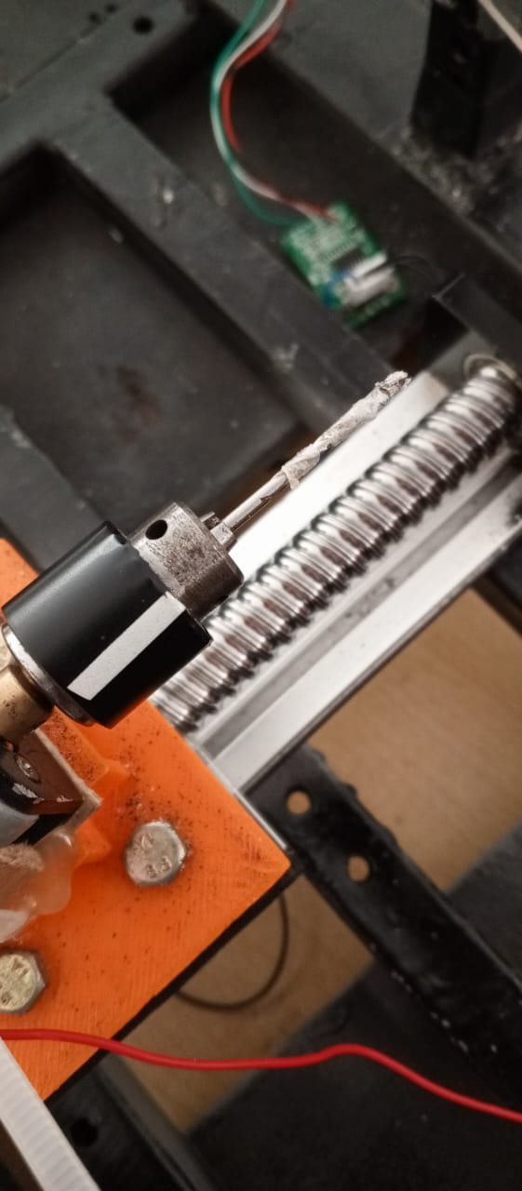
Effect of drilling with maximum speed of the dc motor
The Perspex melts and adheres firmly to the drill bit.
Recommendation made is that the speed has to regulated more consciously to minimize temperature during melting while ensuring optimal drilling action. More experiments will help us achieve this.

Slide 8
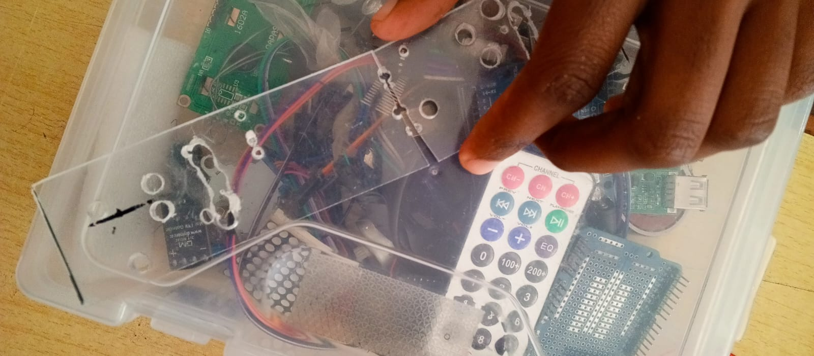
Challenge: Perspex broke when drilling clamping holes Solution: We shall use smaller widths of PMMA for experiments to reduce the number of times one strip has to be drilled.

Slide 9
What we hve not finished yet for presentation in coming week; in progress
Design of Experiment
FEA Force Abaqus
FEA Temperature Ansys
Interfacing TFT screen with Arduino
Reading RPM values of dc motor using rotary motor encoder

